Slide 1


Probability Distributions
And Likelihoods
- A Rigorous Introduction
Main Points: We will go over probability distributions, conditional probabilities, and Bayes Theorem.
6040 Bayesian Machine Learning
Prof. Bill Basener

Slide 2

Topics:
Bayesian methods –> decision + uncertainty.
Optional Videos
Probability Distributions
Probability vs. Likelihood
Bayes Theorem
Chapter 1

Slide 3


Why this course?
Bayesian methods incorporate probability in machine learning. (uncertainty)
Bayesian Machine Learning allows us to customize models to answer more than ‘Machine Learning’. (Bop-it vs. Legos)
Chapter 1

Slide 4
Machine Learning:
Data
Model
Ice Cream Sales
Ice Cream Sales
Temperature
Temperature
Chapter 1

Slide 5
Bayesian Machine Learning:
Data
Ice Cream Sales
Model (with probabilities
on prediction and parameters)
Temperature
95% Conf.
Prior Belief
Ice Cream Sales
Hotter Weather should imply more sales
95% Conf.
Slope is correct with 0.1
Temperature
Chapter 1

Slide 6
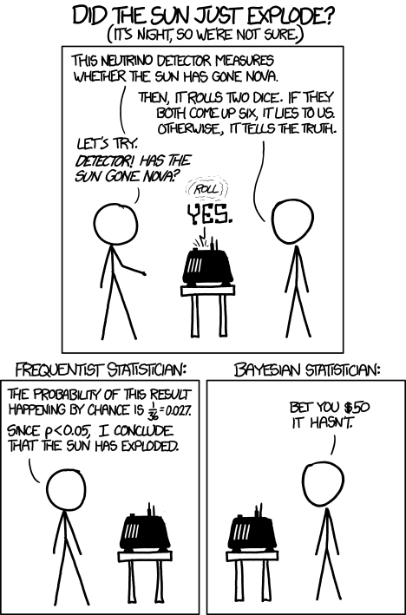
Bayesian Machine Learning:

Slide 7
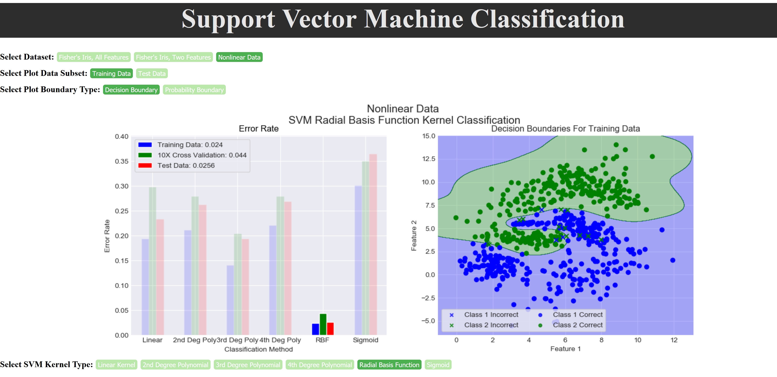
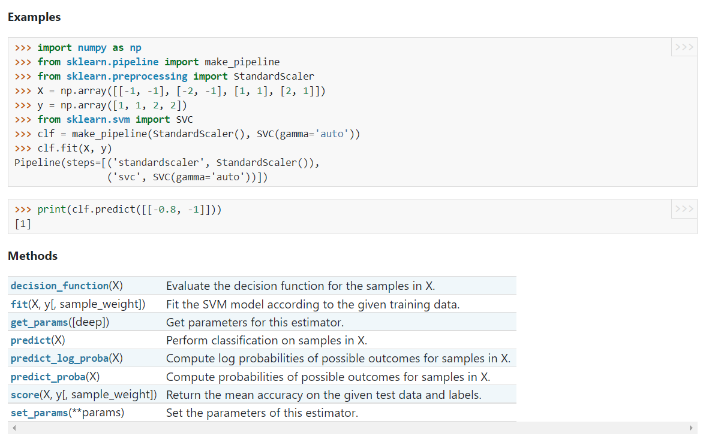
Blue vs. Green represents class decision.
https://scikit-learn.org/stable/modules/generated/sklearn.svm.SVC.html
Chapter 1

Slide 8
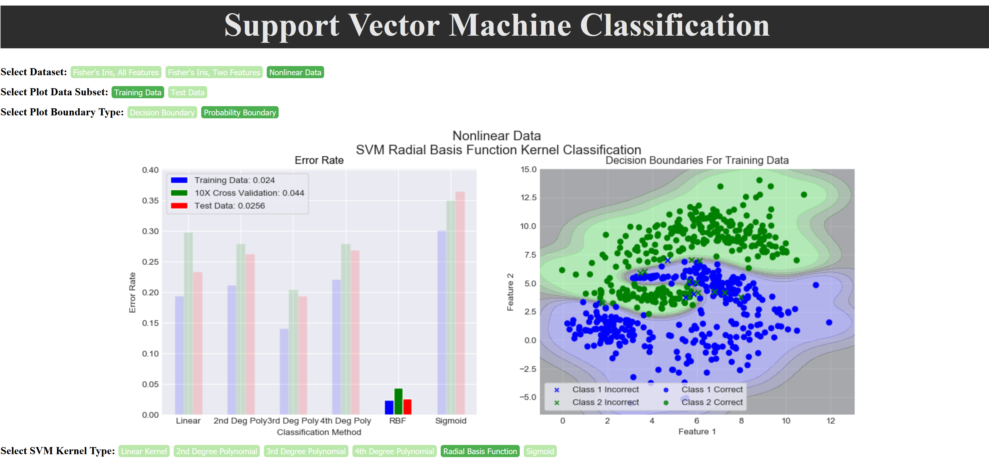
Color scale represents probability for each class (decision + uncertainty).
https://scikit-learn.org/stable/modules/generated/sklearn.svm.SVC.html
Chapter 1

Slide 9

Required Textbook: https://github.com/wbasener/BayesianML
Download and read this week.

Slide 10

Probability Distributions
Example: Rolling a Die
1 | 1/6
2 | 1/6
3 | 1/6
4 | 1/6
5 | 1/6
6 | 1/6
N
P(N=2)=
P(N=2 or N=5)=

Slide 11
Probability Distributions
Color
Example: Rolling a Die
 | R | G
1 | 1/6 | 0
2 | 1/6 | 0
3 | 1/6 | 0
4 | 0 | 1/6
5 | 0 | 1/6
6 | 0 | 1/6
N
P(N=2) =
P(N=2 or C=R) =

Slide 12
Probability Distributions
Color
Example: Rolling a Die
 | R | G
1 | 1/6 | 0
2 | 1/6 | 0
3 | 1/6 | 0
4 | 0 | 1/6
5 | 0 | 1/6
6 | 0 | 1/6
N
“given that”
P(C=R | N=2) =
P(N=2 | C=R) =

Slide 13
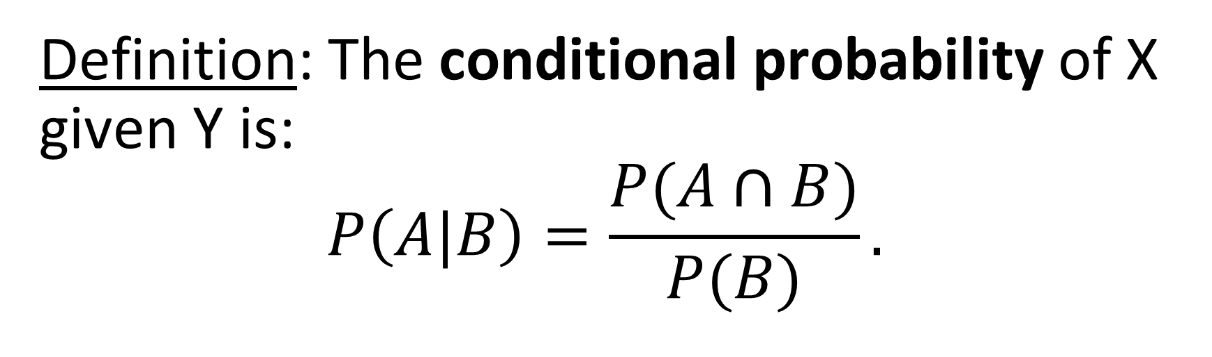



Definition: The conditional probability of X given Y is:
$$P\left(A|B\right)=\frac{P(A∩B)}{P(B)}.$$
$$S$$
$$B$$
$$A$$
Chapter 1

Slide 14
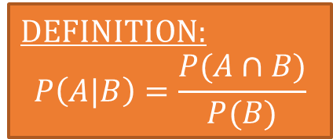
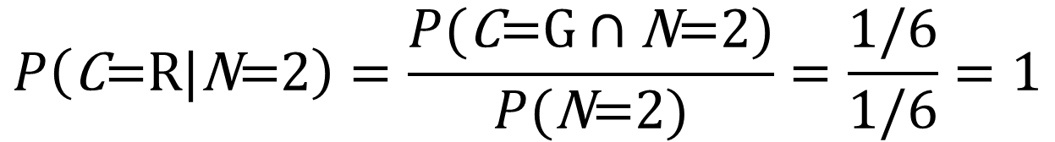
Color
Example: Rolling a Die
 | R | G
1 | 1/6 | 0
2 | 1/6 | 0
3 | 1/6 | 0
4 | 0 | 1/6
5 | 0 | 1/6
6 | 0 | 1/6
DEFINITION:
$$P\left(A|B\right)=\frac{P(A∩B)}{P(B)}$$
N
$$P\left(\text{C}\text{=}\text{R}|\text{N}\text{=2}\right)=\frac{P(\text{C}\text{=}\text{G}∩\text{N}\text{=2})}{P(\text{N}\text{=2})}=\frac{1/6}{1/6}=1$$

Slide 15
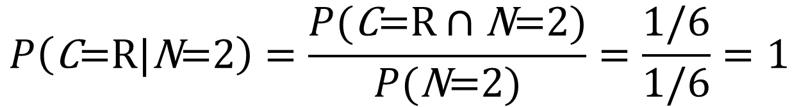
Color
Example: Rolling a Die
 | R | G
1 | 1/6 | 0
2 | 1/6 | 0
3 | 1/6 | 0
4 | 0 | 1/6
5 | 0 | 1/6
6 | 0 | 1/6
DEFINITION:
$$P\left(A|B\right)=\frac{P(A∩B)}{P(B)}$$
N
$$P\left(\text{C}\text{=}\text{R}|\text{N}\text{=2}\right)=\frac{P(\text{C}\text{=}\text{R}∩\text{N}\text{=2})}{P(\text{N}\text{=2})}=\frac{1/6}{1/6}=1$$

Slide 16
Color
Example: Rolling a Die
 | R | G
1 | 1/6 | 0
2 | 1/6 | 0
3 | 1/6 | 0
4 | 0 | 1/6
5 | 0 | 1/6
6 | 0 | 1/6
DEFINITION:
$$P\left(A|B\right)=\frac{P(A∩B)}{P(B)}$$
N
$$P\left(\text{C}\text{=}\text{R}|\text{N}\text{=2}\right)=\frac{P(\text{C}\text{=}\text{R}∩\text{N}\text{=2})}{P(\text{N}\text{=2})}=\frac{1/6}{1/6}=1$$

Slide 17
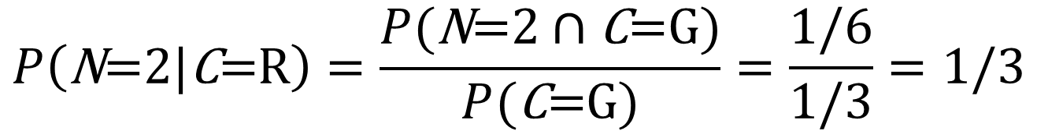
Color
Example: Rolling a Die
 | R | G
1 | 1/6 | 0
2 | 1/6 | 0
3 | 1/6 | 0
4 | 0 | 1/6
5 | 0 | 1/6
6 | 0 | 1/6
DEFINITION:
$$P\left(A|B\right)=\frac{P(A∩B)}{P(B)}$$
N
$$P\left(\text{N}\text{=2}|\text{C}\text{=}\text{R}\right)=\frac{P(\text{N}\text{=2}∩\text{C}\text{=}\text{G})}{P(\text{C}\text{=}\text{G})}=\frac{1/6}{1/3}=1/3$$

Slide 18
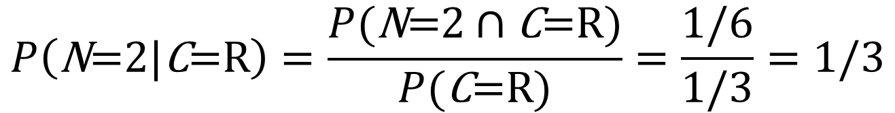
Color
Example: Rolling a Die
 | R | G
1 | 1/6 | 0
2 | 1/6 | 0
3 | 1/6 | 0
4 | 0 | 1/6
5 | 0 | 1/6
6 | 0 | 1/6
DEFINITION:
$$P\left(A|B\right)=\frac{P(A∩B)}{P(B)}$$
N
$$P\left(\text{N}\text{=2}|\text{C}\text{=}\text{R}\right)=\frac{P(\text{N}\text{=2}∩\text{C}\text{=}\text{R})}{P(\text{C}\text{=}\text{R})}=\frac{1/6}{1/3}=1/3$$

Slide 19
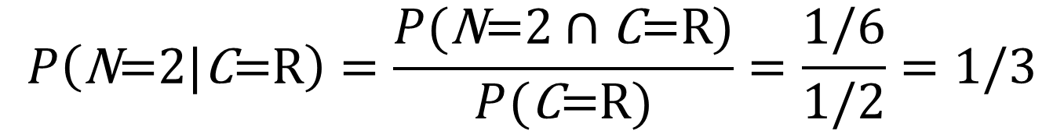
Color
Example: Rolling a Die
 | R | G
1 | 1/6 | 0
2 | 1/6 | 0
3 | 1/6 | 0
4 | 0 | 1/6
5 | 0 | 1/6
6 | 0 | 1/6
DEFINITION:
$$P\left(A|B\right)=\frac{P(A∩B)}{P(B)}$$
N
$$P\left(\text{N}\text{=2}|\text{C}\text{=}\text{R}\right)=\frac{P(\text{N}\text{=2}∩\text{C}\text{=}\text{R})}{P(\text{C}\text{=}\text{R})}=\frac{1/6}{1/2}=1/3$$

Slide 20
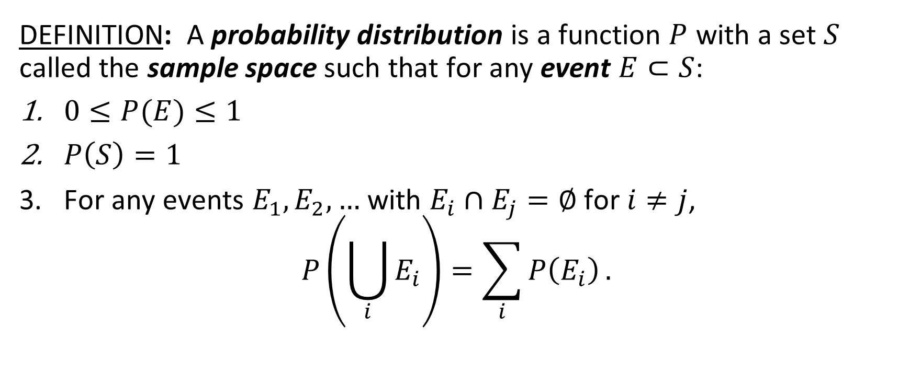
Probability Distributions
The set S is the set of all possible outcomes. For example, S={1,2,3,4,5,6} for rolling a die.
DEFINITION: A probability distribution is a function $P$ with a set $S$ called the sample space such that for any event $E⊂S$:
$0≤P(E)≤1$
$P\left(S\right)=1$
For any events $E_{1},E_{2},…$ with $E_{i}∩E_{j}=∅$ for $i≠j$,
$$P\left(\bigcup_{i}{E_{i}}\right)=\sum_{i}{P\left(E_{i}\right)}.$$
An ‘event’ E might be a single element of S (ie ‘roll a 2’, E={2}) or it might be a subset of S (ie ‘roll an even number’, E={2,4,6}.)

Slide 21
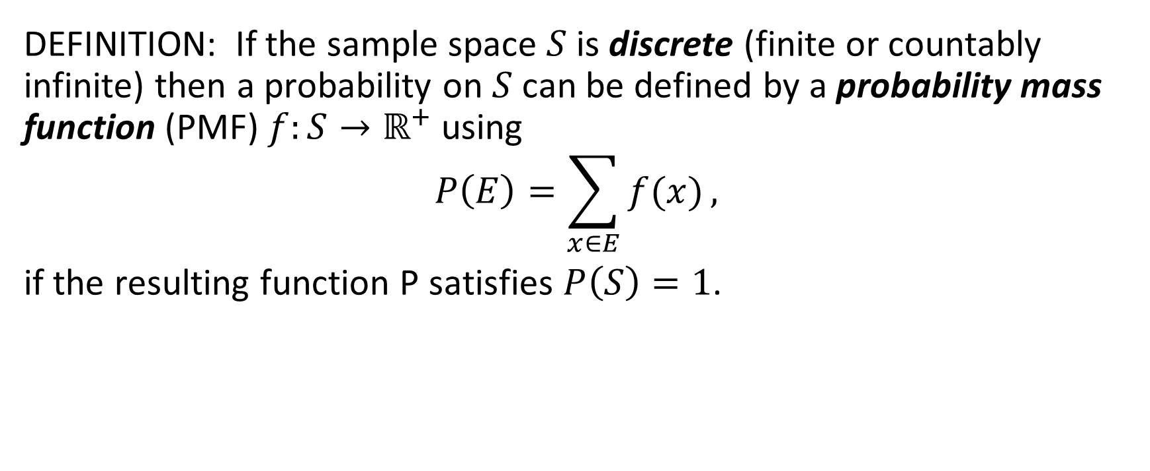
Probability Distributions
DEFINITION: If the sample space $S$ is discrete (finite or countably infinite) then a probability on $S$ can be defined by a probability mass function (PMF) $f:S→ℝ^{+}$ using
$$P\left(E\right)=\sum_{x∈E}{f(x)},$$
if the resulting function P satisfies $P\left(S\right)=1$.
NOTATION:
If a probability has a discrete sample space, we say that the probability distribution is discrete.

Slide 22
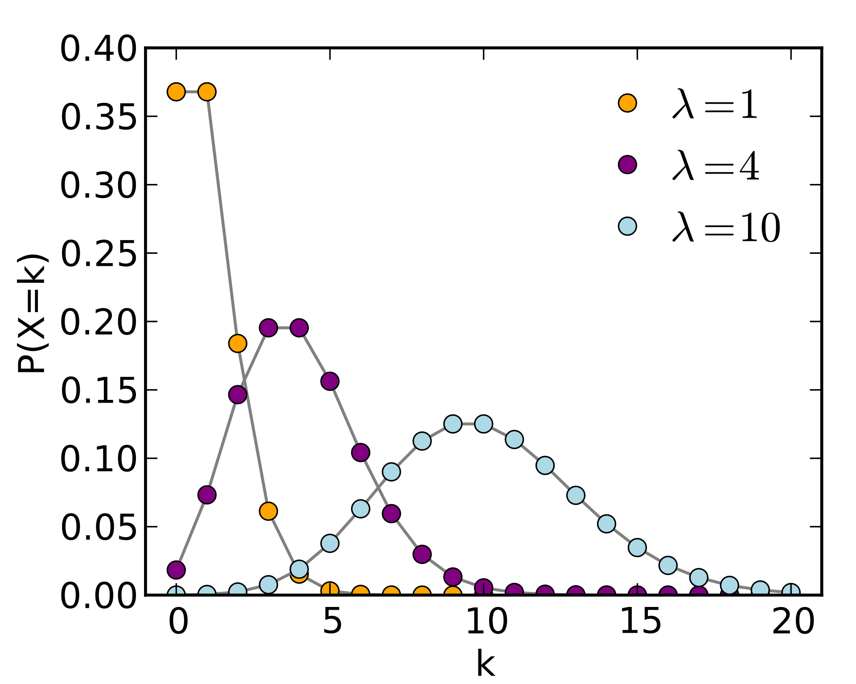
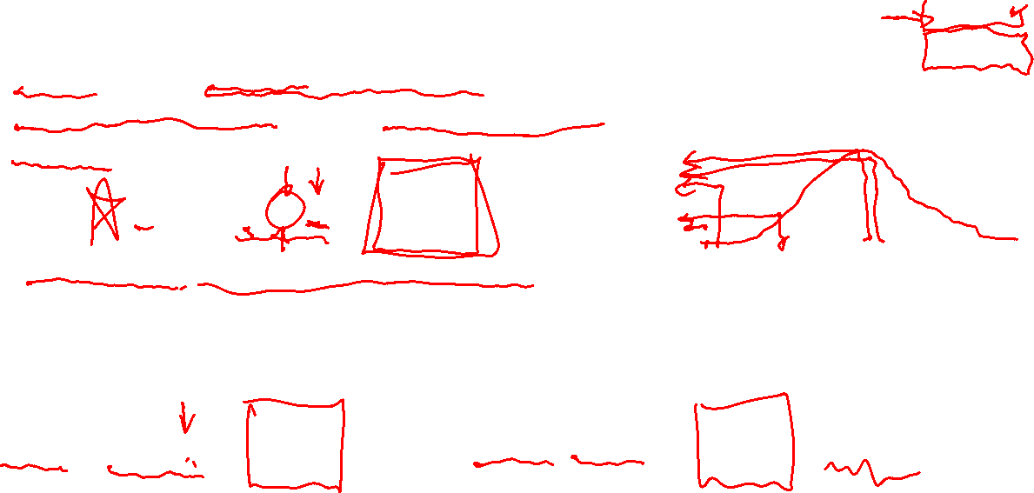
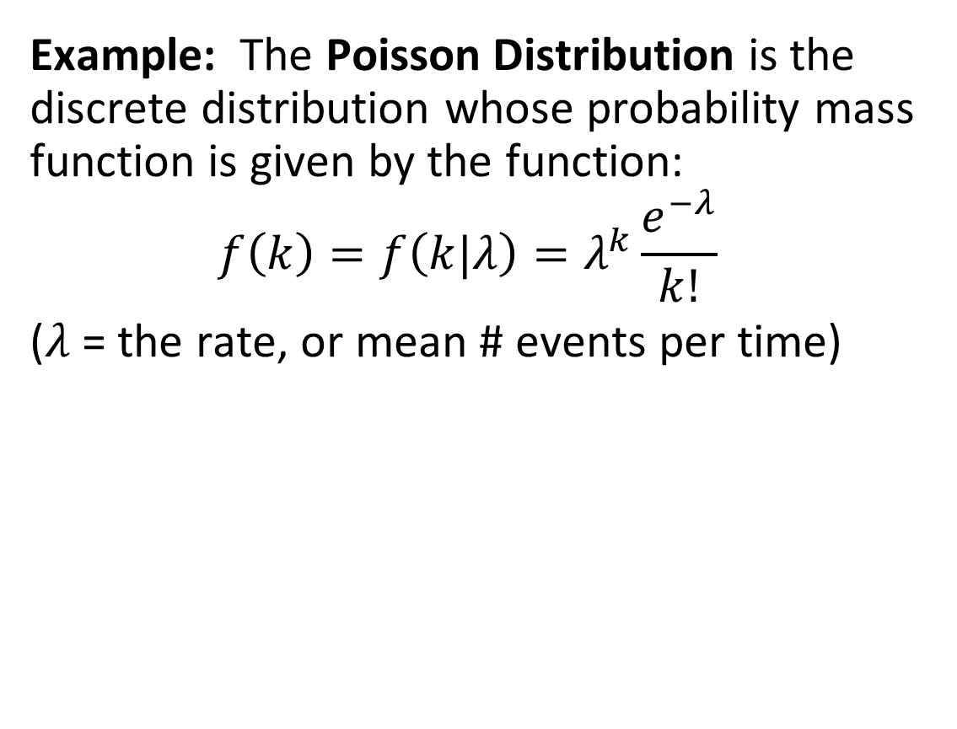
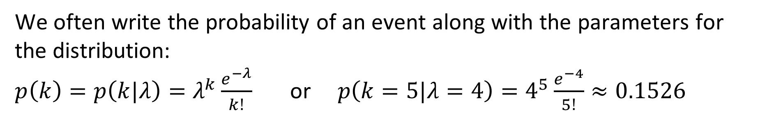
Probability Distributions
Example: The Poisson Distribution is the discrete distribution whose probability mass function is given by the function:
$$f\left(k\right)=f\left(k|λ\right)=λ^{k}\frac{e^{−λ}}{k!}$$
($λ$ = the rate, or mean # events per time)
The probability of having 5 car accidents on Rt 29, given that the average number of accidents per month is 4.
We often write the probability of an event along with the parameters for the distribution:
$p\left(k\right)=p\left(k|λ\right)=λ^{k}\frac{e^{−λ}}{k!}$ or $p\left(k=5|λ=4\right)=4^{5}\frac{e^{−4}}{5!}≈0.1526$

Slide 23
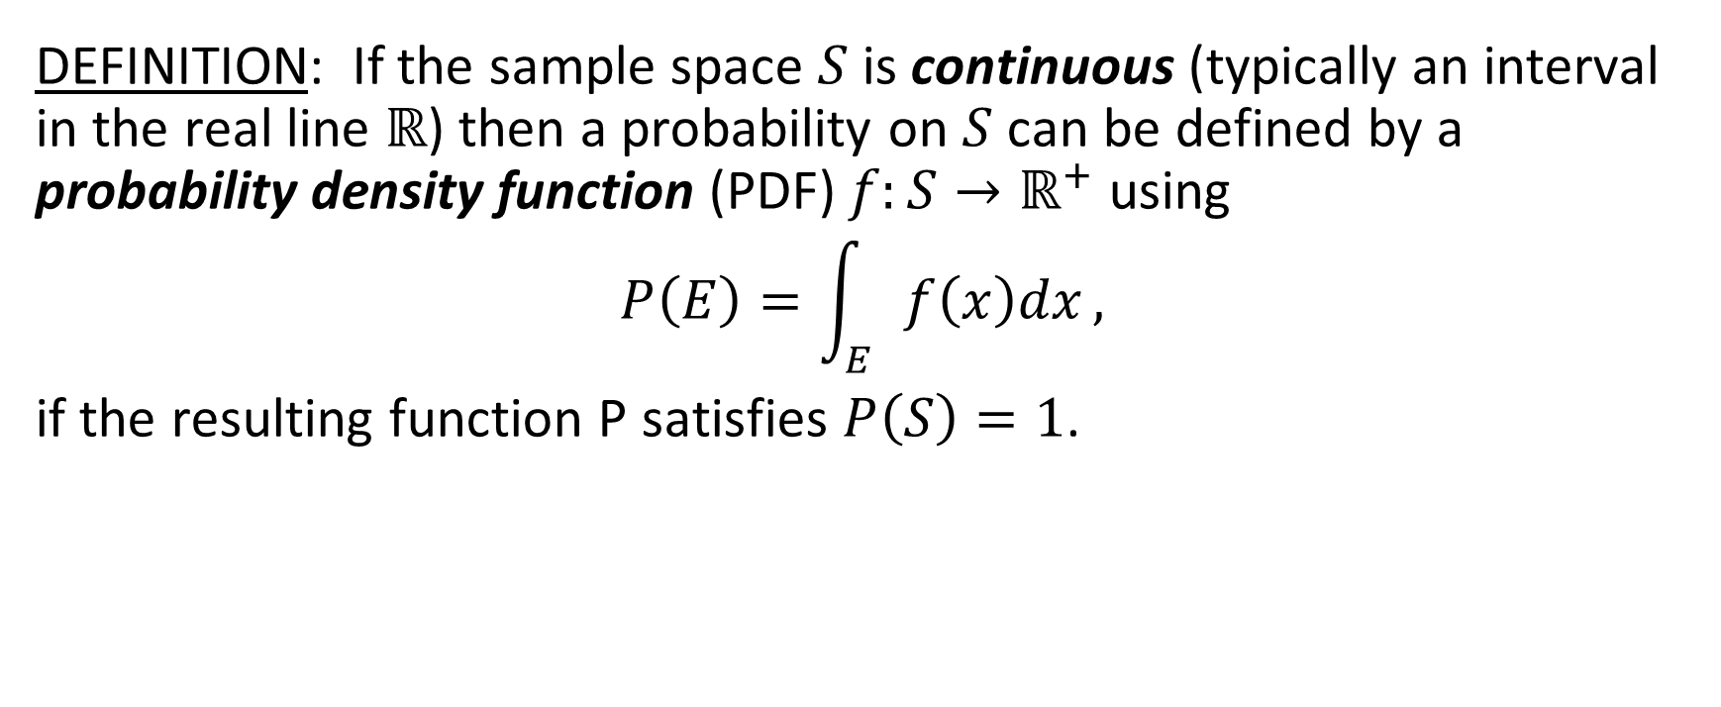
Probability Distributions
DEFINITION: If the sample space $S$ is continuous (typically an interval in the real line $ℝ$) then a probability on $S$ can be defined by a probability density function (PDF) $f:S→ℝ^{+}$ using
$$P\left(E\right)=\int_{E}{f\left(x\right)dx},$$
if the resulting function P satisfies $P\left(S\right)=1$.
NOTATION:
If a probability has a continuous sample space, we say that the probability distribution is continuous.
$ℝ^{+}=[0,∞)$

Slide 24
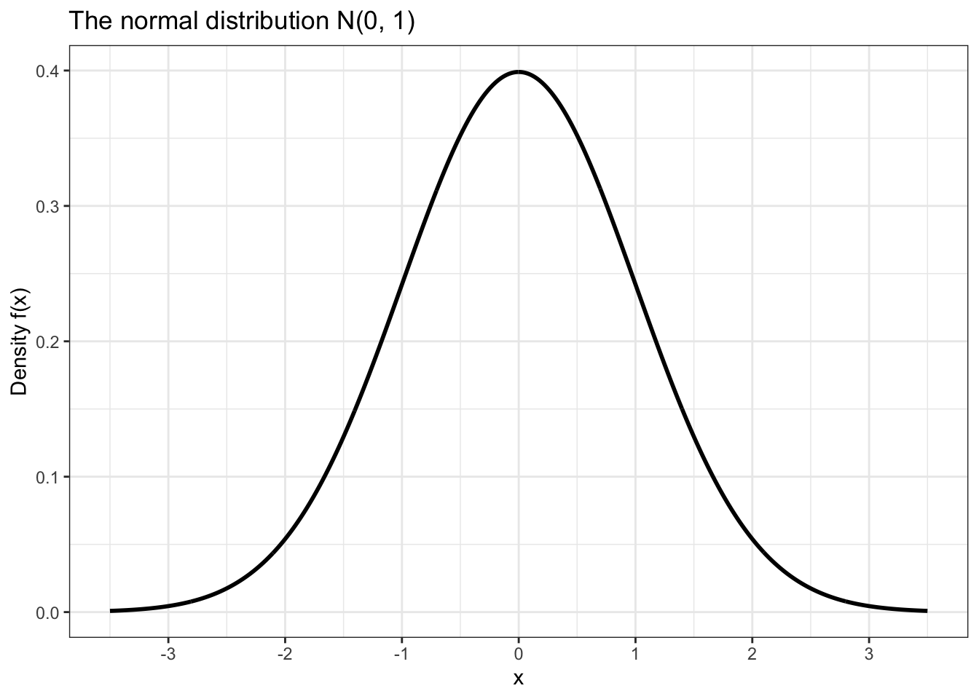
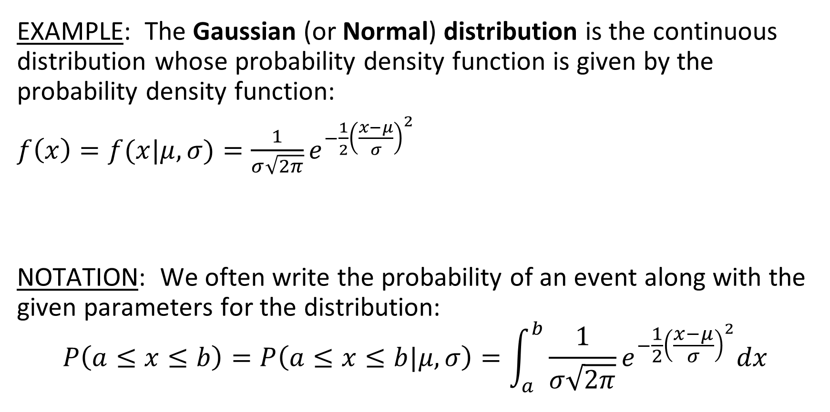
Probability Distributions
EXAMPLE: The Gaussian (or Normal) distribution is the continuous distribution whose probability density function is given by the probability density function:
$f\left(x\right)=f(x|μ,σ)=\frac{1}{σ\sqrt{2π}}e^{−\frac{1}{2}{\left(\frac{x−μ}{σ}\right)}^{2}}$
NOTATION: We often write the probability of an event along with the given parameters for the distribution:
$$P\left(a≤x≤b\right)=P\left(a≤x≤b|μ,σ\right)=\int_{a}^{b}{\frac{1}{σ\sqrt{2π}}e^{−\frac{1}{2}{\left(\frac{x−μ}{σ}\right)}^{2}}dx}$$

Slide 25
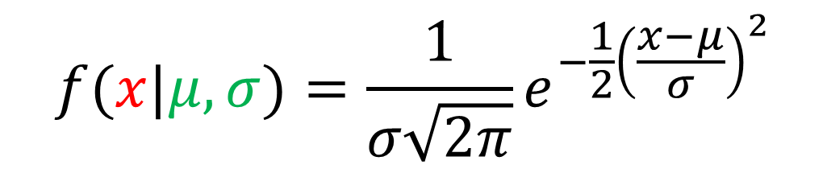
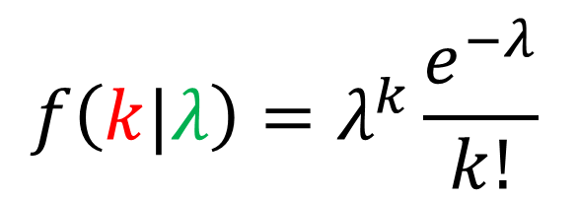
NOTE: We often describe probability of “output” given “parameters”.
In Bayesian Statistics, we will care about probability of parameters (model) given output (observed data)
$$f(x|μ,σ)=\frac{1}{σ\sqrt{2π}}e^{−\frac{1}{2}{\left(\frac{x−μ}{σ}\right)}^{2}}$$
$$f\left(k|λ\right)=λ^{k}\frac{e^{−λ}}{k!}$$
Chapter 1

Slide 26
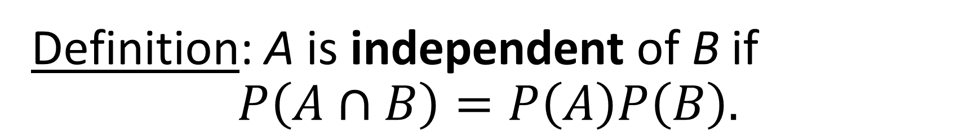

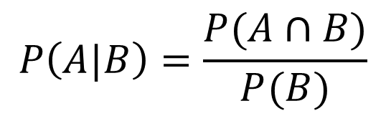
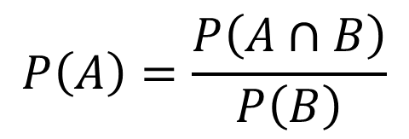

Definition: A is independent of B if
$$P\left(A∩B\right)=P\left(A\right)P\left(B\right).$$
$$P\left(A\right)P\left(B\right)=P\left(A∩B\right)$$
$$P\left(A\right)=\frac{P\left(A∩B\right)}{P\left(B\right)}$$
Definition of conditional probability:
$$P\left(A|B\right)=\frac{P(A∩B)}{P(B)}$$
$$P\left(A\right)=P\left(A|B\right)$$
Chapter 1

Slide 27
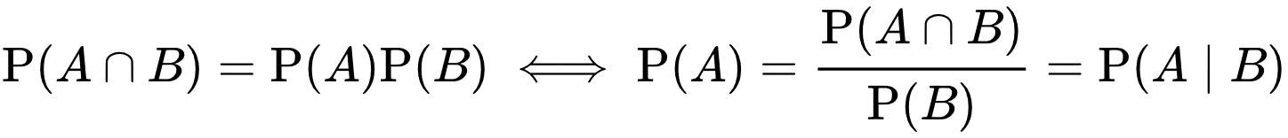
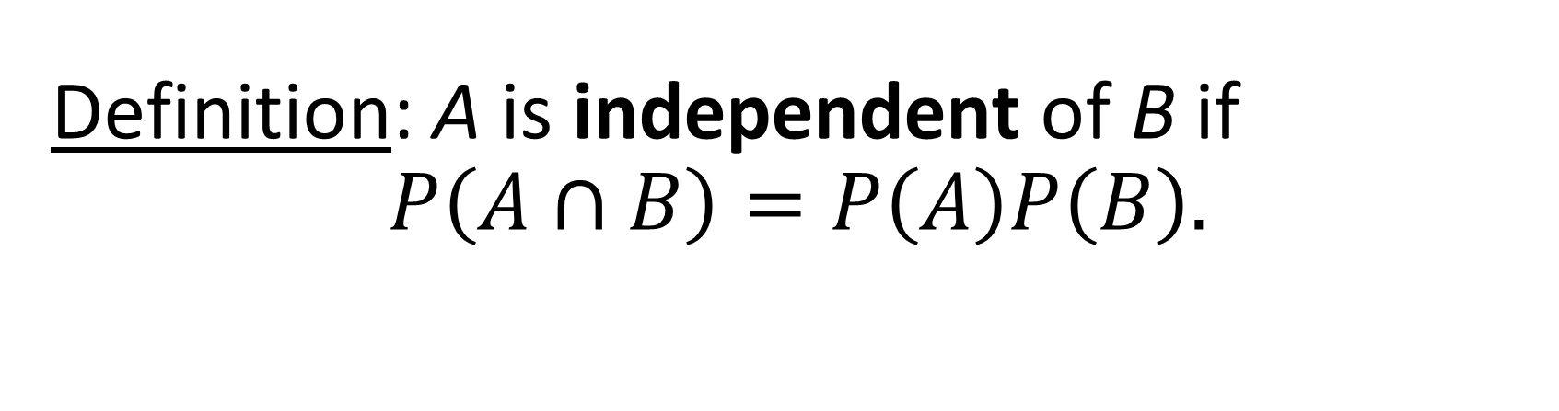
Definition: A is independent of B if
$$P\left(A∩B\right)=P\left(A\right)P\left(B\right).$$
Chapter 1

Slide 28




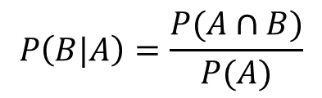
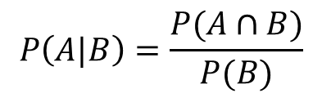
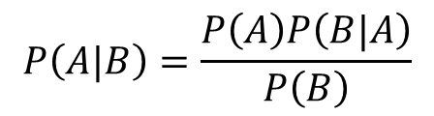
Bayes Theorem:
$$P\left(A|B\right)=\frac{P(B|A)P\left(A\right)}{P\left(B\right)}$$
PROOF:
$$P\left(A|B\right)=\frac{P(A∩B)}{P(B)}$$
$$P\left(B|A\right)=\frac{P(A∩B)}{P(A)}$$
Definition of conditional probability.
$$P(B)P\left(A|B\right)=P(A∩B)$$
$$P(A)P\left(B|A\right)=P(A∩B)$$
Algebra.
$$P\left(B\right)P\left(A|B\right)=P(A)P\left(B|A\right)$$
Equality.
$$P\left(A|B\right)=\frac{P\left(A\right)P\left(B|A\right)}{P\left(B\right)}$$
Algebra.
QED.
Chapter 1

Slide 29

Likelihoods
DEFINITION: For a given probability distribution P and data X, the likelihood function is a function L defined by
$$L\left(θ|X\right)=f(X|θ)$$
Where $f(X|θ)$ is the PDF (continuous case) or PMF (discrete case) for the probability distribution P.
NOTATION: We often write $L\left(θ|X\right)=P\left(X | θ\right)$, using the notation for the discrete case (where the probability mass function f is equal to the probability distribution for individual points in S).
You should see that this is mathematically TRIVIAL. All we are doing is treating the parameters as viariables in the likelihood and the data is assumed fixed, whereas in the PMF/PDF the data is treated as the variable and the parameters are assumed to be fixed.

Slide 30



Likelihoods
DEFINITION: For a given probability distribution P and data X, the likelihood function is a function L defined by
$$L\left(θ|X\right)=f(X|θ)$$
Where $f(X|θ)$ is the PDF (continuous case) or PMF (discrete case) for the probability distribution P.
NOTATION: We often write $L\left(θ|X\right)=P\left(X | θ\right)$, using the notation for the discrete case (where the probability mass function f is equal to the probability distribution for individual points in S).
Example: $λ$ = the rate, or mean # events per time
$$f\left(k|λ\right)=λ^{k}\frac{e^{−λ}}{k!}$$
$f\left(k|λ\right)$ = the probability of observing $k$ events if the rate is $λ$.
$L\left(λ|k\right)$ = the likelihood for $λ$ if $k$ events were observed.

Slide 31
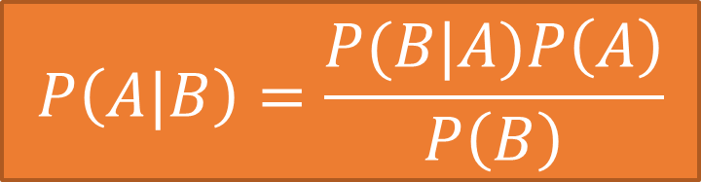
Bayes Theorem:
From Previous Slide:
$$P\left(A|B\right)=\frac{P(B|A)P\left(A\right)}{P\left(B\right)}$$
*From Video 1.13 on “Expectation and Conditioning”

Slide 32

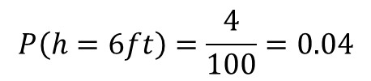
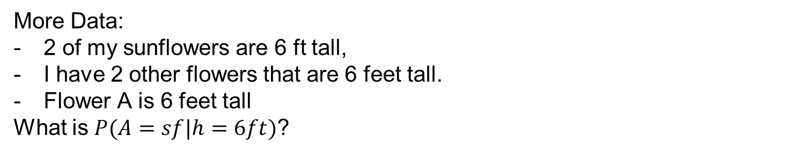

Bayes Theorem:
$$P\left(A|B\right)=\frac{P(B|A)P\left(A\right)}{P\left(B\right)}$$
Use, updating belief:
Data: I have 100 flowers in my yard, 3 of which are sunflowers.
What is $P(A=sf$)? (A is a random variable for the type of flower, sf=sunflower.)
$$P(A=sf)=\frac{3}{100}=0.03$$
More Data:
2 of my sunflowers are 6 ft tall,
I have 2 other flowers that are 6 feet tall.
Flower A is 6 feet tall
What is $P(A=sf|h=6ft)$?
$$P\left(h=6ft|A=sf\right)=2/3$$
$$P\left(h=6ft\right)=\frac{4}{100}=0.04$$
Chapter 1

Slide 33
Bayes Theorem:
$$P\left(A|B\right)=\frac{P(B|A)P\left(A\right)}{P\left(B\right)}$$
Chapter 1

Slide 34

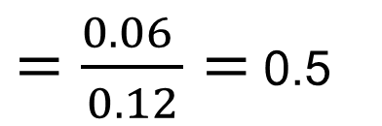

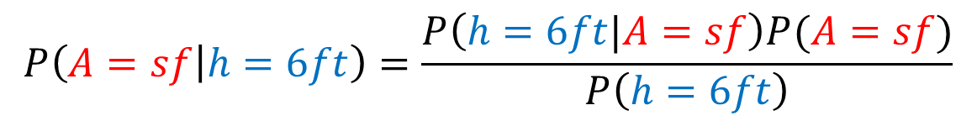
Bayes Theorem:
$$P\left(A|B\right)=\frac{P(B|A)P\left(A\right)}{P\left(B\right)}$$
Use, updating belief:
Prior Probability
Data: I have 100 flowers in my yard, 3 of which are sunflowers.
What is $P(A=sf$)? (A is a random variable for the type of flower, sf=sunflower.)
$$P(A=sf)=\frac{3}{100}=0.03$$
More Data:
2 of my sunflowers are 6 ft tall,
I have 2 other flowers that are 6 feet tall.
Flower A is 6 feet tall
What is $P(A=sf|h=6ft)$?
$$P\left(h=6ft|A=sf\right)=2/3$$
$$P\left(h=6ft\right)=\frac{4}{100}=0.04$$
Posterior Probability
$$P\left(A=sf | h=6ft\right)=\frac{P\left(h=6ft|A=sf\right)P(A=sf)}{P\left(h=6ft\right)}$$
$$=\frac{2/3×0.03}{0.04}$$
$=\frac{0.06 }{0.12}=$ 0.5
Chapter 1

Slide 35

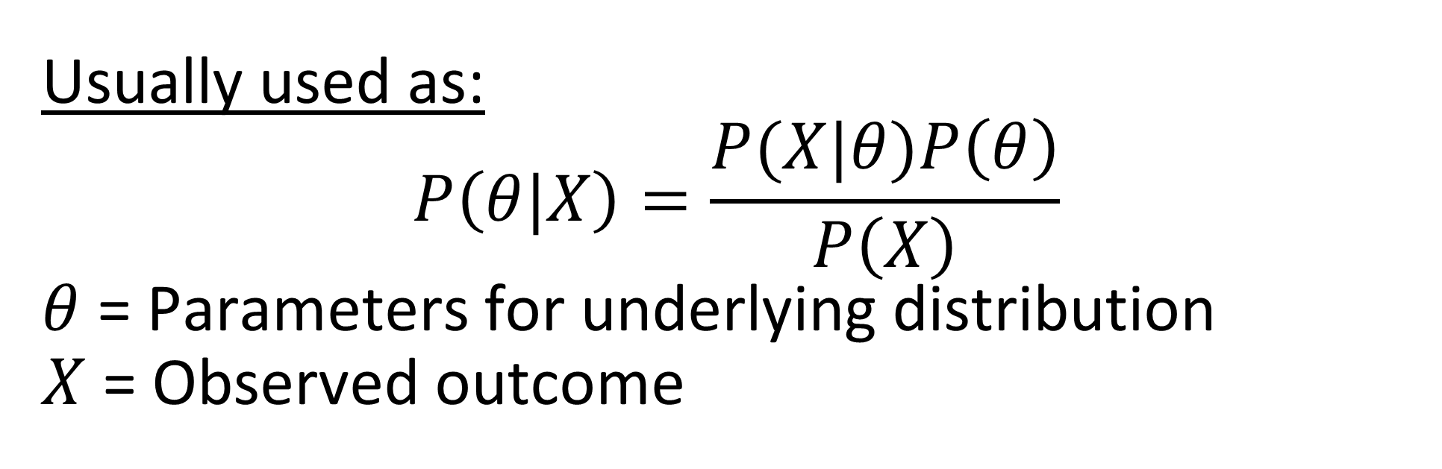
Bayes Theorem:
$$P\left(A|B\right)=\frac{P(B|A)P\left(A\right)}{P\left(B\right)}$$
Usually used as:
$$P\left(θ|X\right)=\frac{P(X|θ)P\left(θ\right)}{P\left(X\right)}$$
$θ$ = Parameters for underlying distribution
$X$ = Observed outcome
Chapter 1

Slide 36
Probability Distributions, Likelihoods, and Bayes Theorem (Kaggle Notebook)
https://www.kaggle.com/billbasener/probabilities-likelihoods-and-bayes-theorem

